Slide 1

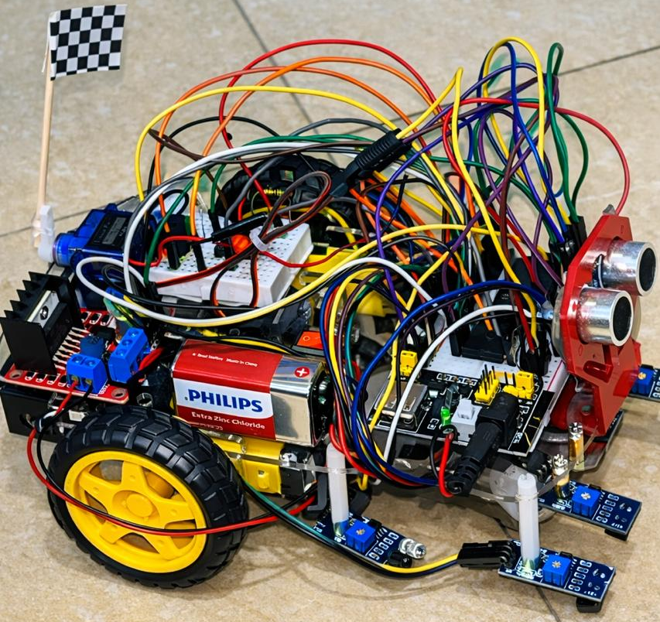
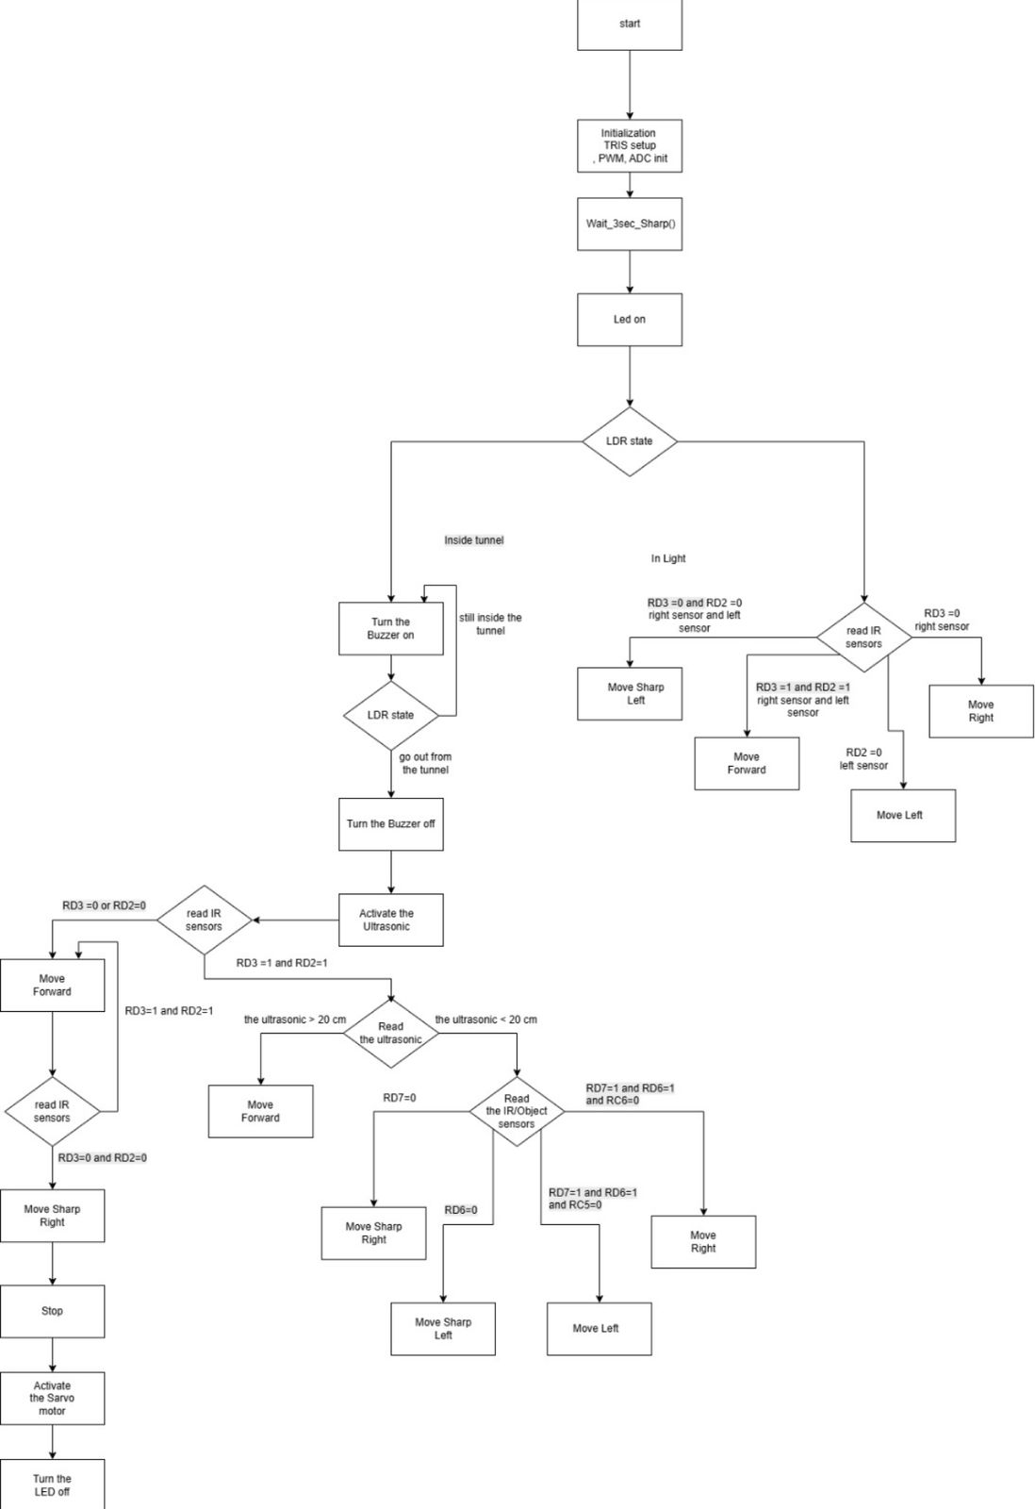
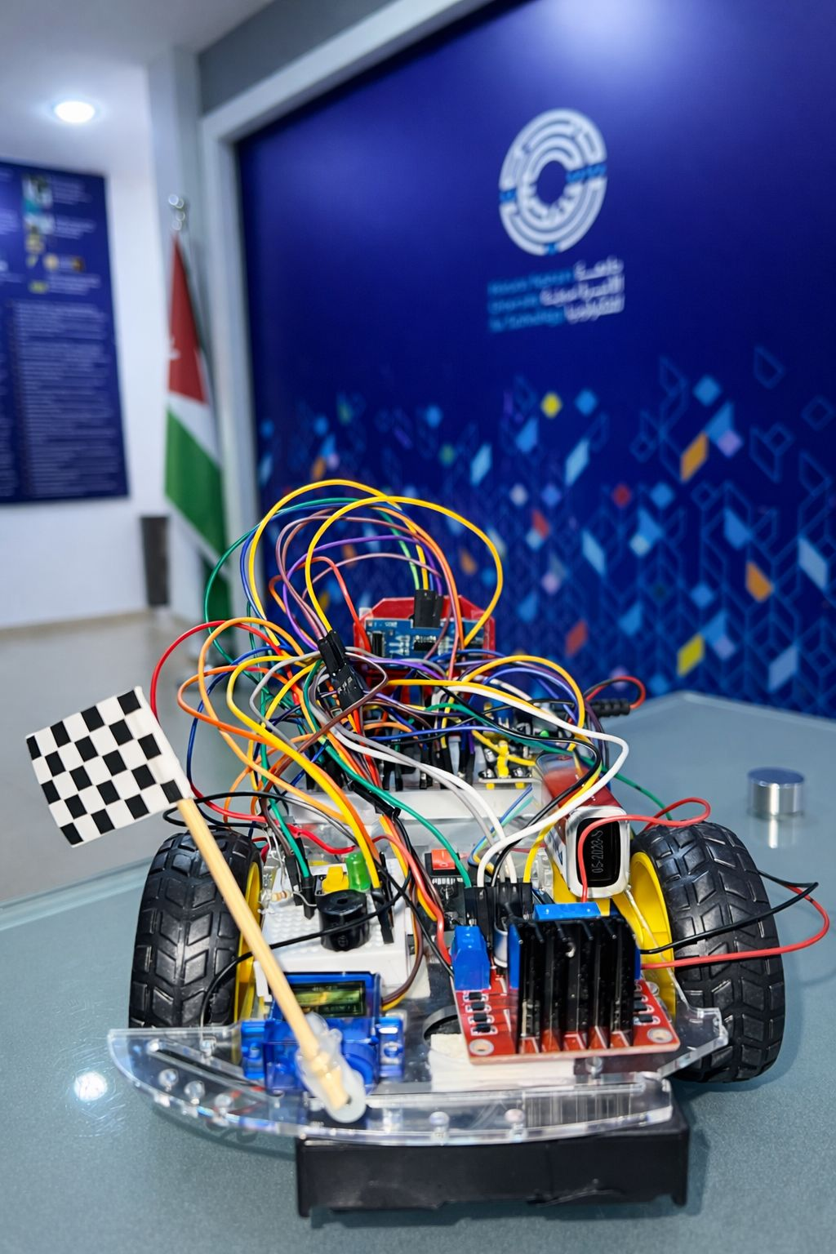
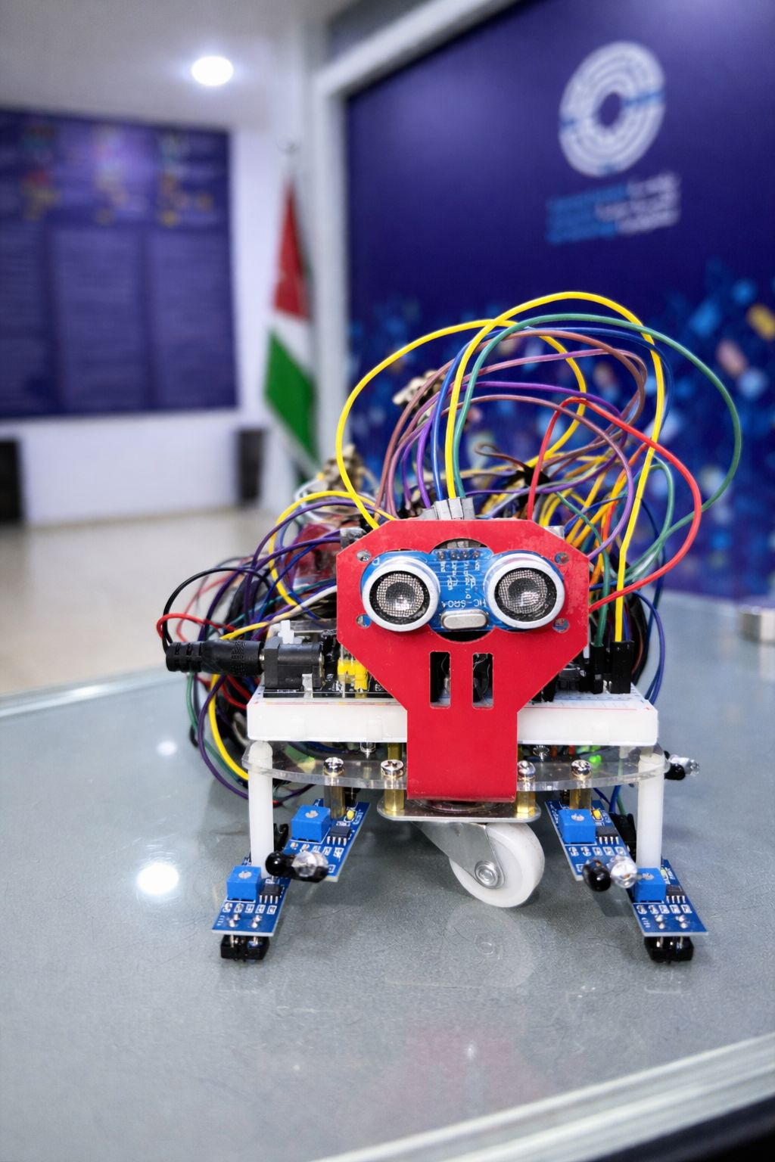
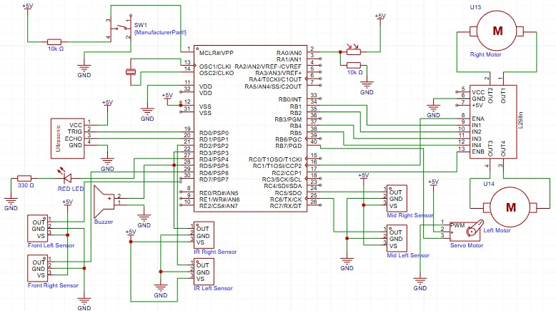
Smart Autonomous Robot
L. Safadi, J. Almosrati , B. Alsaket
Supervisor: Dr. Esam, Qaralleh
Embedded Systems Final Design Project, Fall 2025
King Abdullah II School of Engineering
Princess Sumaya University for Technology
Introduction
Autonomous mobile robots are widely used in embedded systems that require real-time sensing and control without human intervention. This project presents the design and implementation of an autonomous mobile robot capable of navigating a multi-zone track, including line following, tunnel detection, obstacle handling, and parking.
The robot uses infrared sensors, an ultrasonic sensor, and an LDR to perceive its environment, while a microcontroller processes sensor data and controls motors, indicators, and actuators. The results demonstrate reliable autonomous behavior and successful completion of all track stages.
Results
Figure 2: Robot Car
Figure 3 & 4: Rear and Front of Car
Figure 5 : Schematic Design
Design
The following flowchart describes the robot’s navigation and control logic:
.
The schematic illustrates the complete hardware integration of the system, where the microcontroller successfully interfaces with multiple sensors and actuators to support reliable autonomous navigation across all track stages.
Figure1:Software’s flowchart
Conclusion
This project demonstrates how an embedded, sensor-based control system can enable autonomous navigation in environments with varying conditions. The robot successfully completed all track stages, showing that structured decision logic and effective sensor integration allow the system to adapt to different navigation scenarios.
The results confirm that combining multiple sensors with well-defined control flow provides a reliable and practical approach for real-world autonomous mobile robot applications.

